Slide 1
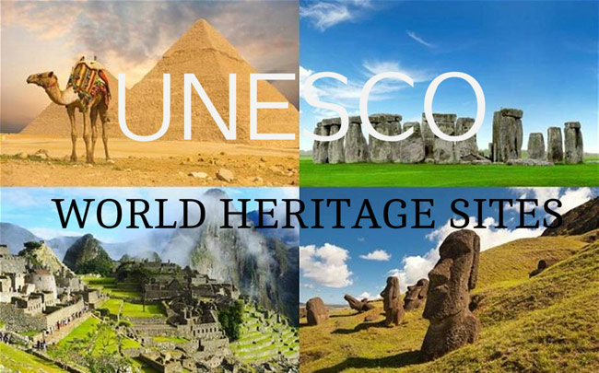
Discovering

Slide 2
Discovering World Heritage Sites
United Nations Educational, Scientific and Cultural Organisation ‘UNESCO’

Slide 3
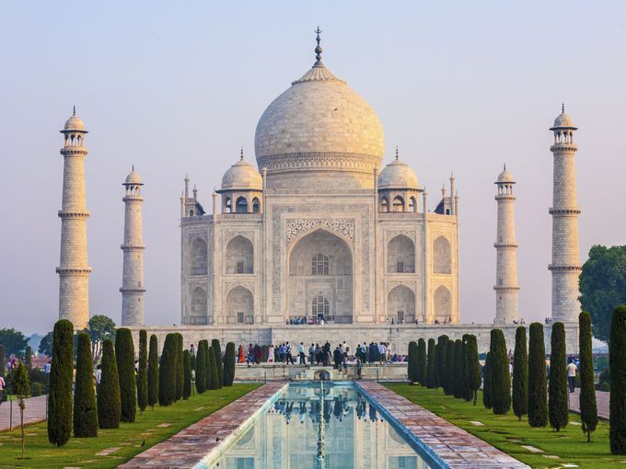
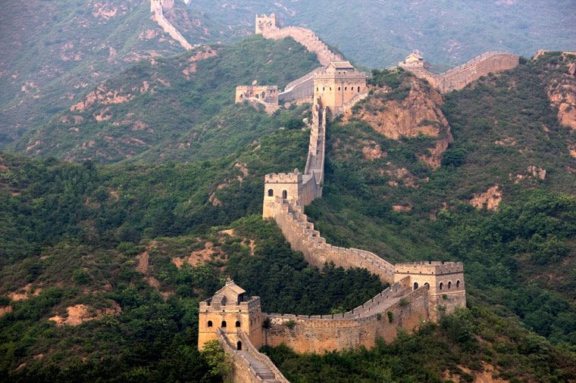
What is a UNSECO World Heritage Site?
It is a place (such as a forest, mountain, lake, desert, monument, building, complex, or city) that is listed by UNESCO because of its special cultural or physical significance. The list is maintained by the international World Heritage Programme.

Slide 4
Australia’s responsibility
UNESCO was established in 1946 as a specialised agency of the United Nations and Australia is a founding member.
Australia became one of the first countries to ratify (agree to) the World Heritage Convention, which is the main law of UNESCO.
This means that Australia must protect and preserve places that have environmental or cultural significance.

Slide 5

How do we determine what goes on the list?
UNESCO decides what sites will make it onto the heritage list. The site (place) must meet one of the criteria for either cultural or natural heritage and be of ‘outstanding universal value’.

Slide 6
Cultural criteria
Monuments with exceptional historical, art or scientific values
Groups of buildings and sites showing interaction of humans and environment
3. Archaeological research area
Notes:
‘Masterpiece of human creative genius’
Shows important interchange of human values, over a span of time, or within a cultural area of the world,
Bears a testimony to a cultural tradition or to civilization which is living or which has disappeared“
Outstanding architecture or type of building or landscape which illustrates a significant stage in human history“
Example of a traditional human settlement, land-use, or sea-use which is representative of a culture, or human interaction with the environment
is associated with events or living traditions, with ideas, or with beliefs, with artistic and literary works of outstanding universal significance’.

Slide 7
Natural Criteria
Sites must have outstanding examples of:
1. The earth’s natural processes
2. Plant and animal diversity
3. Exceptional phenomena
4. Natural beauty
5. Natural habitat
Notes:
Contains natural phenomena or areas of exceptional natural beauty and aesthetic importance.
An outstanding example representing major stages of Earth's history for example significant on-going geological processes in the development of landforms.
An outstanding example representing significant on-going ecological and biological processes in the evolution and development of the marine world.
Contains the most important and significant natural habitats for in-situ conservation of biological diversity, including those containing threatened species.

Slide 8
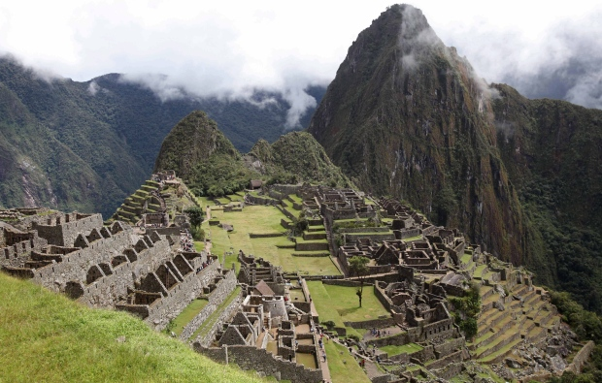
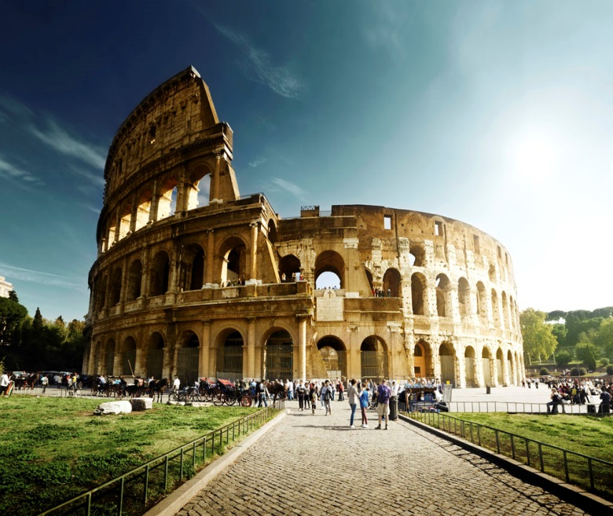
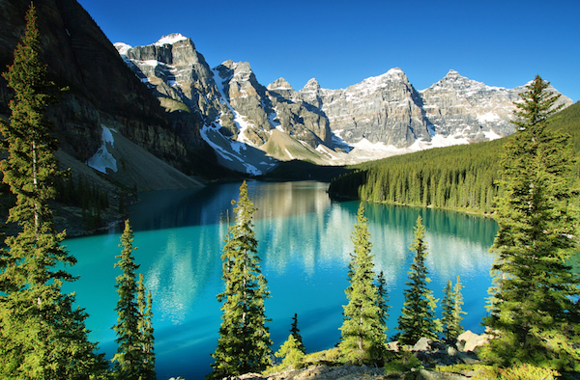
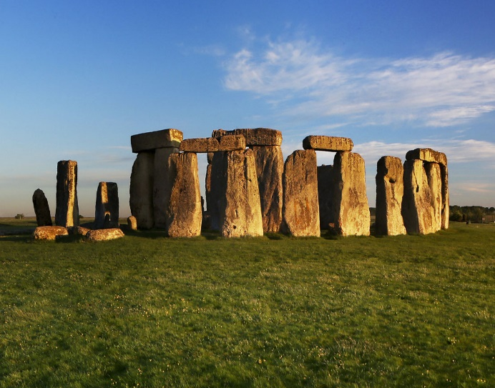
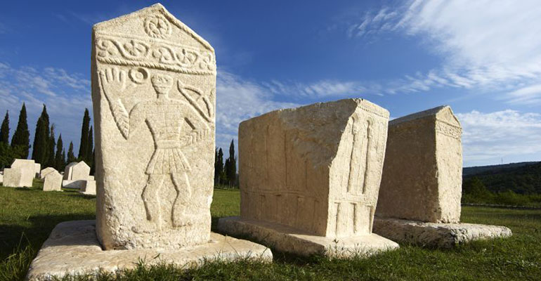
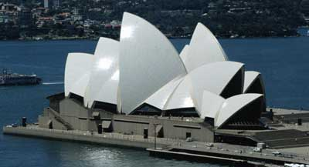
Brainstorm
Can you think of any World Heritage sites?
Create a brainstorm graphic organiser in your workbook.
Come up with as many sites (places) that you think of that are World Heritage Sites.
Notes:
Explain how to set out brainstorm, can use ready made worksheet. Use pictures as clues

Slide 9
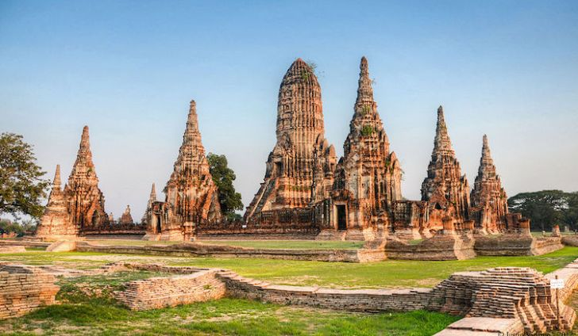
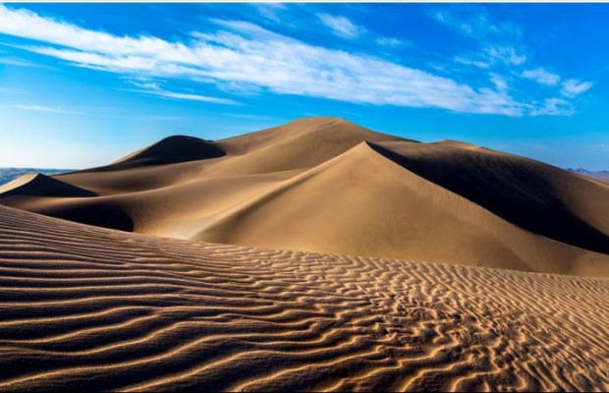
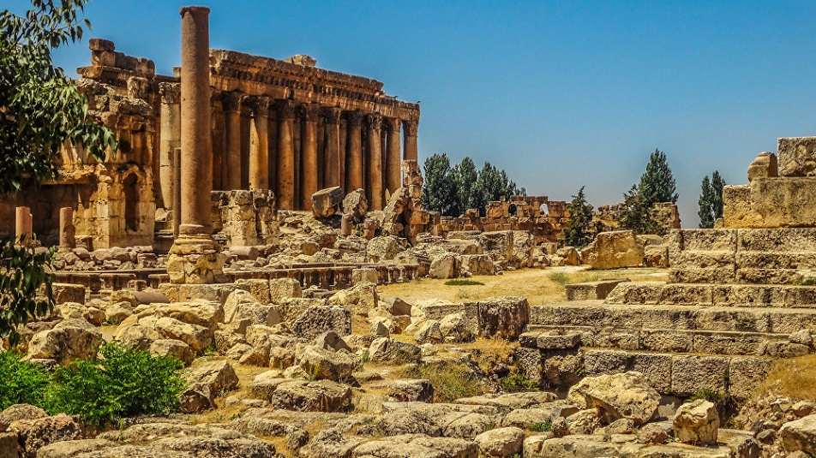
Benefits of World Heritage listing
International co-operation to protect cultural or natural places of 'outstanding universal value' so that future generations may enjoy them as we do now.
Tourism
Global recognition
Puts responsibilities on to countries to protect.

Slide 10
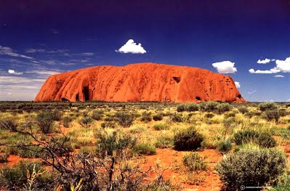
Think task: Australian sites on UNESCO
Uluru - why does it fit the criteria to be on the list?

Slide 11
World Heritage Top 12
The countries with the most World Heritage listed properties are:
1. Italy: 49 sites 2. China: 45 sites 3. Spain: 44 sites 4. Germany: 38 sites 5. France: 38 sites
6. Mexico: 32 sites 7. India: 30 sites 8. United Kingdom: 28 sites 9. Russian Federation: 25 sites 10. USA: 21 sites 11. Australia: 19 sites 12. Brazil: 19 sites

Slide 12
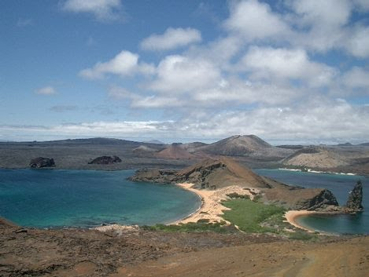
Galapogas Islands
About 120 islands situated in the Pacific Ocean about 1000 km from South America
Ongoing seismic and volcanic activity reflects the processes that formed the islands.
Isolation led to the development of unusual animal life such as the land iguana, the giant tortoise.
Inspired Darwin and his theory of ‘natural selection’ because of the ‘living museum and showcase of evolution’ of the islands.
Landscape features include crater lakes, fumaroles, lava tubes and sulphur fields.

Slide 13
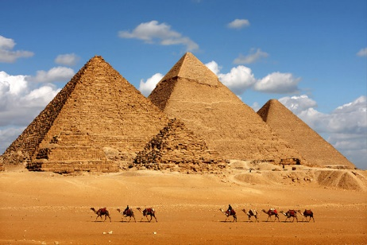
Pyramids of Giza
The last remaining wonder of the Seven Wonders of the World.
Pharaoh Khufu built the largest of the great pyramids in 2250 B.C.
Consists of approximately 2.3 million line stone blocks and 20 years to build.
It was constructed so that each of its sides faced exactly north, south, east and west.
2.3 million stone blocks were cut from quarries along the Nile River by farmers.

Slide 14
Great Wall of China
Construction began in the 7th Century B.C. It’s purpose was the protect the northern boards of the Chinese Empire from invaders.
It is estimated that the length is over 6,000km and can be seen from space.
Built by frontier guards, peasants, the unemployed, disgraced noblemen, and convicts during the Qin and Han dynasties.
It is interspersed with watchtowers at regular intervals that were used as lookouts.

Slide 15
Sites that are under threat
https://www.youtube.com/watch?v=6-K079txZe8

Slide 16
World heritage sites - Queensland
https://www.youtube.com/watch?v=jaKvW0lNNkc

Slide 17
Kakadu national park
https://www.youtube.com/watch?v=I7zT43kTcrQ

Slide 18
Fraser island
https://www.youtube.com/watch?v=IPhrlXiUSFc

Slide 19
Gondwana rainforests
https://www.youtube.com/watch?v=XDXvGmYQY4I

Slide 20
ULURU
https://www.youtube.com/watch?v=I72SIE19UX0

Slide 21
Great barrier reef
https://www.youtube.com/watch?v=GAyRBqKk3hk

